Slide 1
Verification Through Simulation
Chris Baldassano
PSYC GR6130, Fall 2019

Slide 2
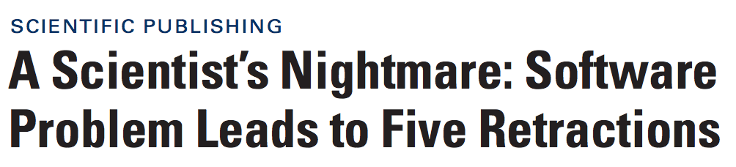

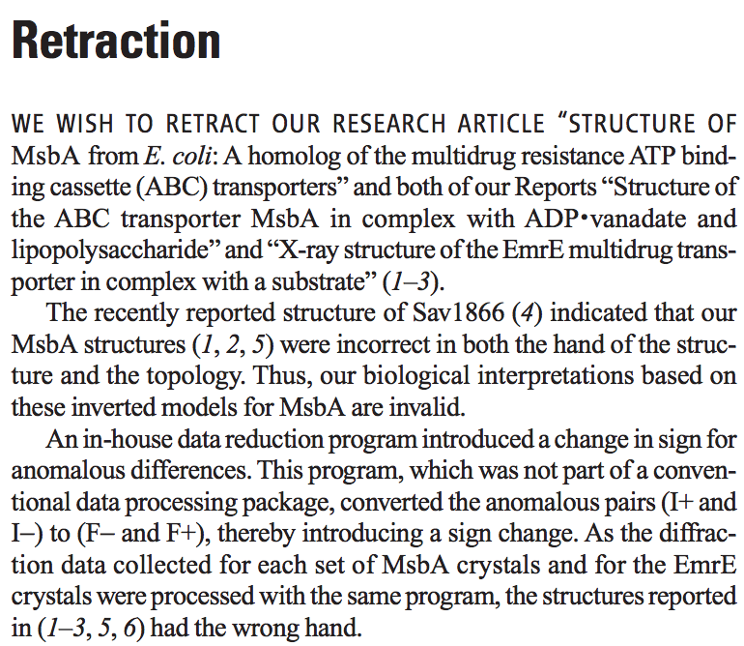
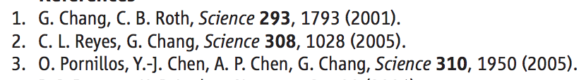

Slide 3


Slide 4

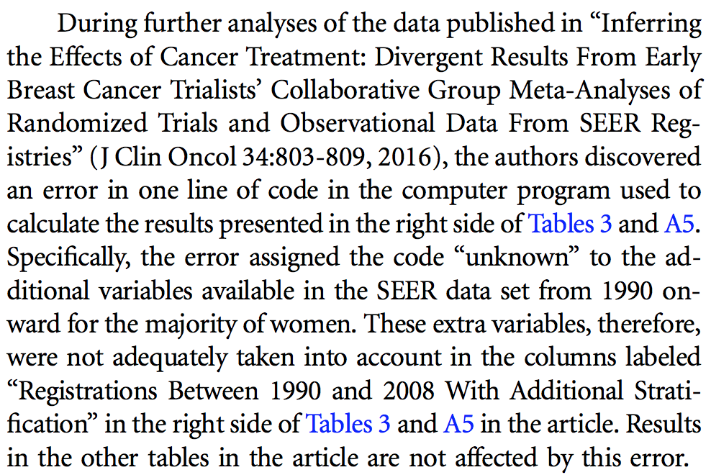

Slide 5

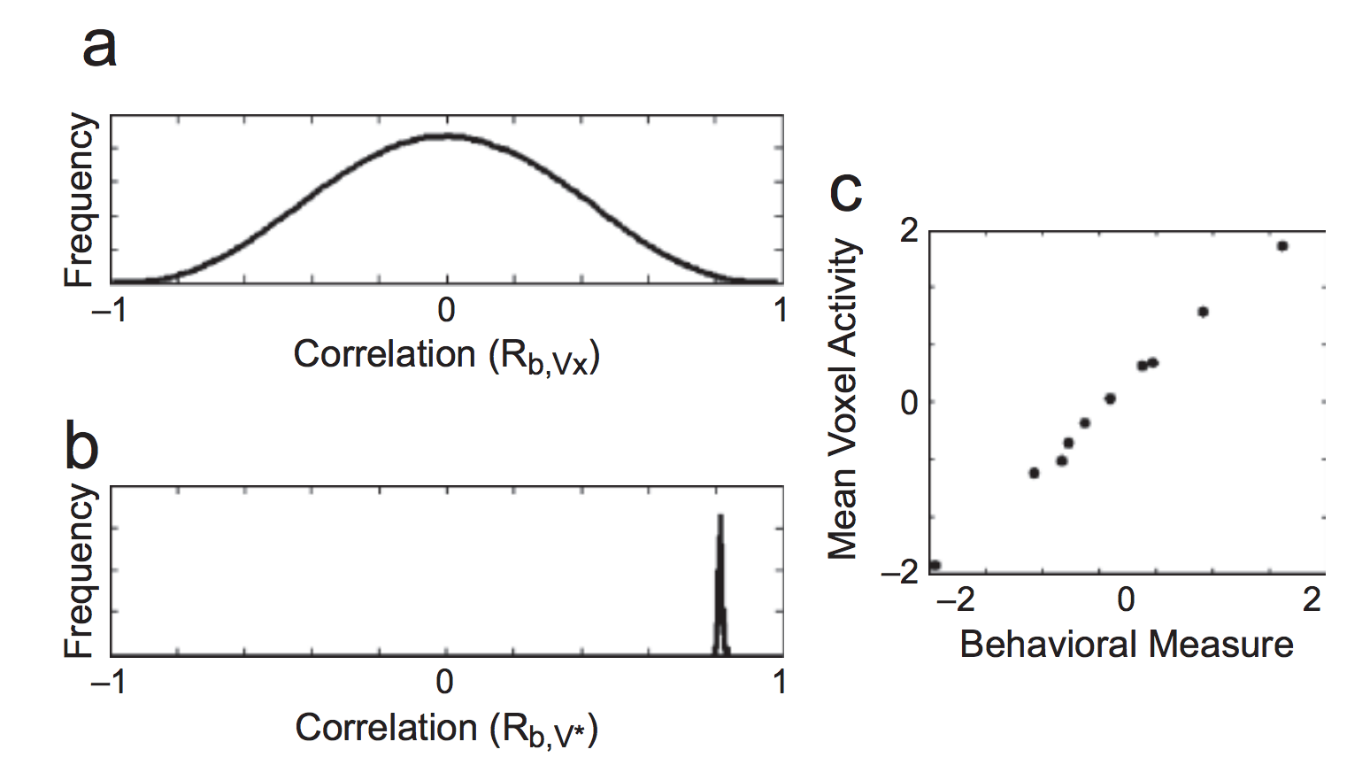
Vul et al. 2009

Slide 6
Verifying analysis pipelines
Academic research is an ideal breeding ground for analysis mistakes:
Researchers are not software engineers
Custom, experiment-specific analyses
No “ground truth” outputs to compare to
Still limited sharing of data and code
How to check analyses?
Run multiple converging, independent analyses
Test output for specific toy inputs (next week)
Use simulated data to test how the analysis functions (today)

Slide 7
Simulating Data
Idea: treat the analysis pipeline as a black box
Swap out the real data for either:
Simulated/permuted data with a null effect, check that result of the analysis does not find an effect
Simulated data with varying signal-to-noise ratio, quantify the sensitivity of the analysis

Slide 8
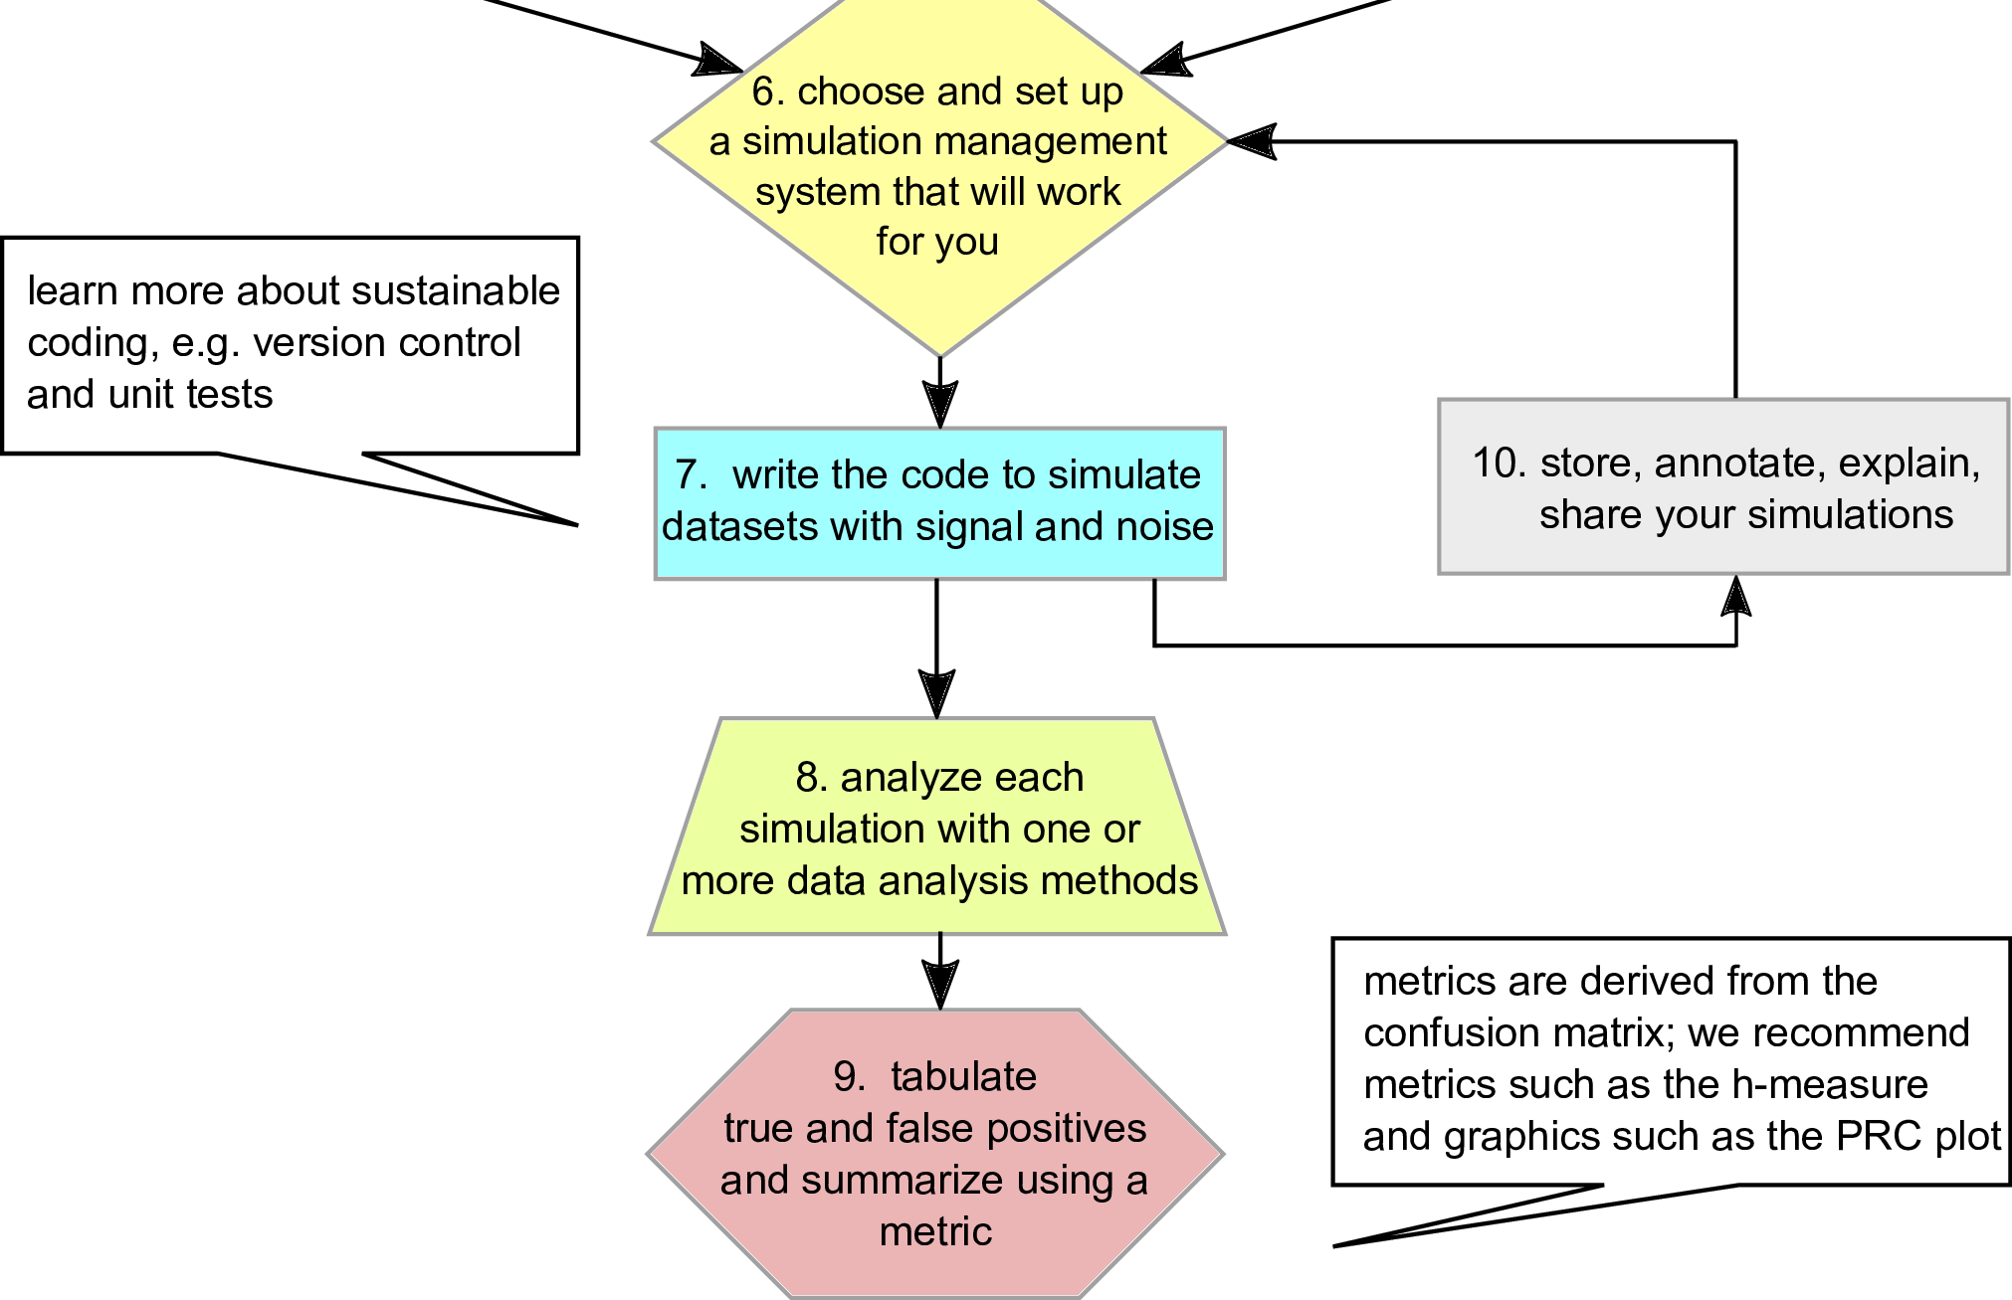
Lotterhos et al. 2018

Slide 9
Challenge: How to simulate?
Some types of simulations:
Permuting real data to ensure that the null hypothesis is true
E.g. permuting group labels, permuting correspondence across two quantities being correlated, permuting phases of signal in frequency space
Sampling data from your generative model, to check if parameters can be recovered
Building a (partial) model of the data-generating process with realistic statistical structure
Note: if you don’t require real data, then you can run these simulations before running the experiment!

Slide 10
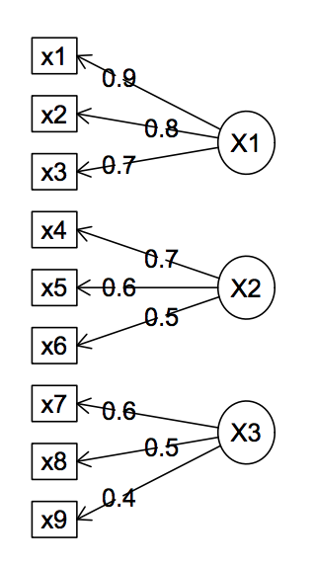
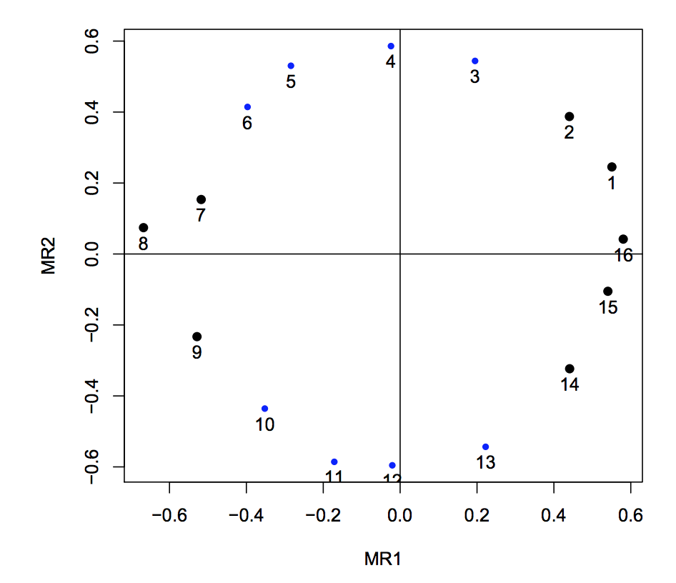
R Psych package – sim functions
Can generate data for structural models, Item Response Theory models, anova, etc.

Slide 11
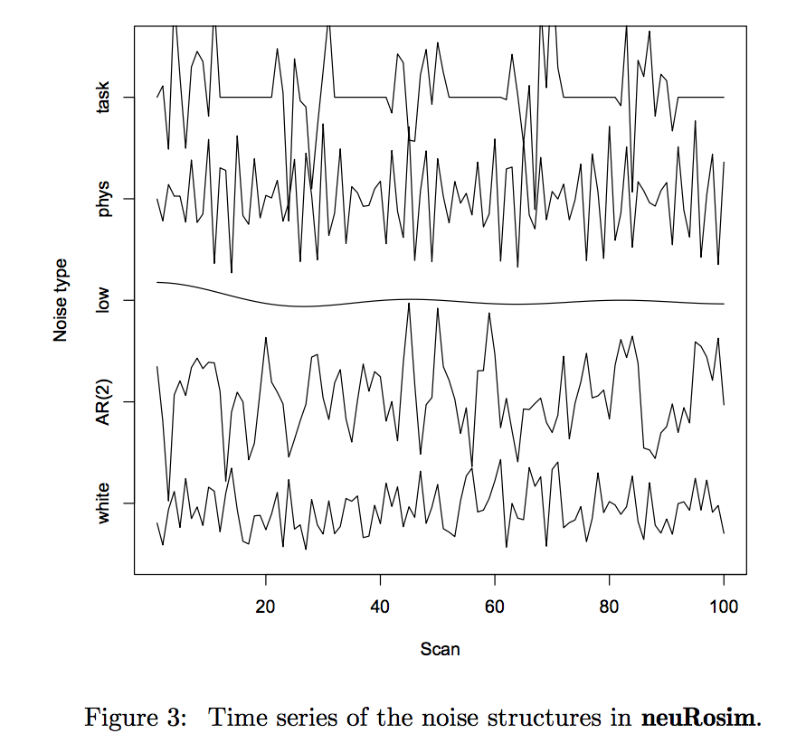
NeuRosim – fMRI simulation in R

Slide 12
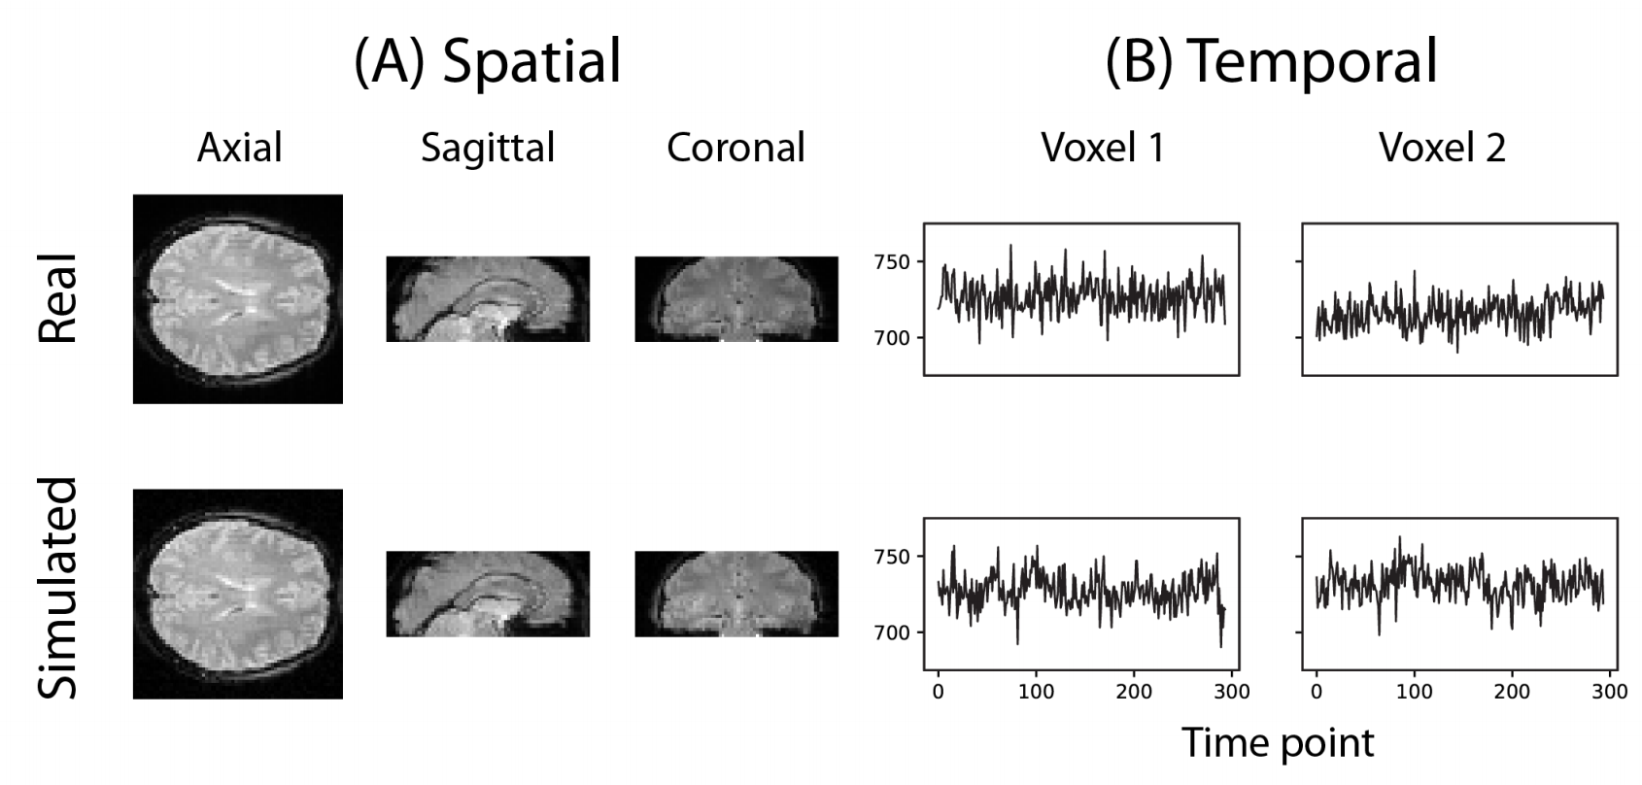
Fmrisim – fmri simulation in python

Slide 13
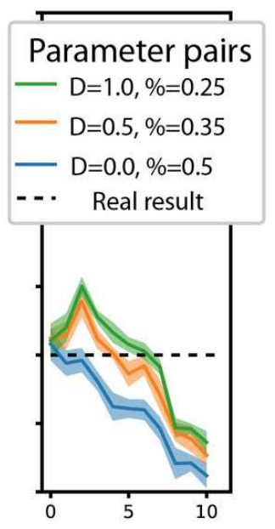
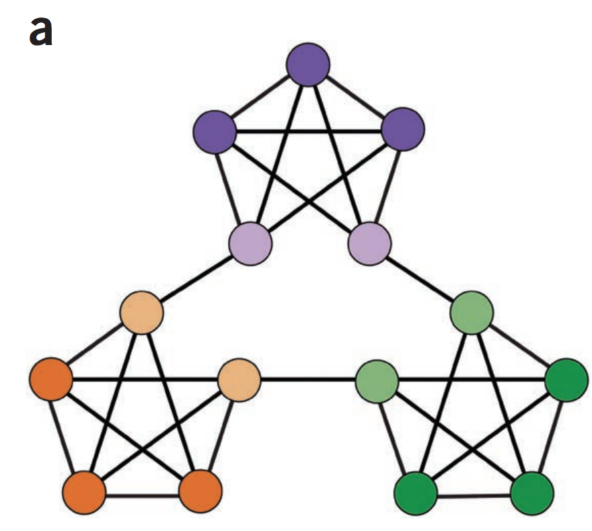

Fmrisim – fmri simulation in python
Schapiro et al. 2013
Ellis et al. bioRxiv 2019

Slide 14
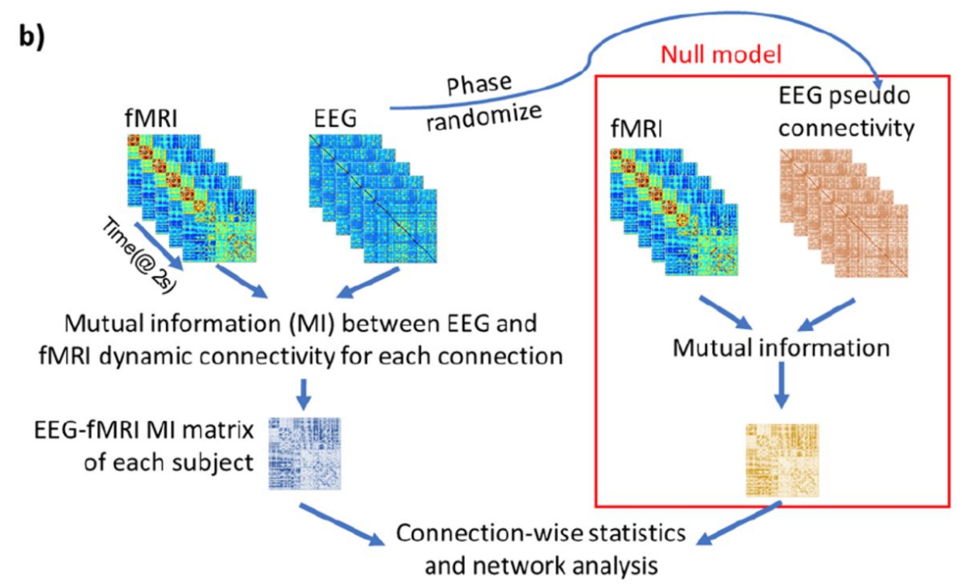
Phase_Randomize (Brainiak UTILS)
Wirsich et al. bioRxiv 2018

Slide 15
Using simulated data in a pipeline
Having a reproducible pipeline makes running simulations much easier, since we can automatically run the “real” analysis
Two general options:
If you just want to test a single simulated dataset (e.g. if your data consists of many statistically independent items which can each be simulated), you could just replace the real data with the simulated data and re-run your pipeline
If you want to run many simulations, you can add a new path to your pipeline that runs and summarizes the simulations

Slide 16
Using simulated Data
Manuscript text
Analysis
Plot results
Real paper
Real Data
Simulated Data

Slide 17
Using simulated Data
Manuscript text
Analysis
Plot results
Real paper
Real Data
x1000
Plot simulated results
Simulated Data

Slide 18
Lab
Clone assignment: https://classroom.github.com/a/qdxeXxIk
Open report.Rmd
Remember to git commit and push when you are done!

